Slide 1
Final Review (In Class Test Portion)

Slide 2
The goal of Principal Components Analysis
PCA is a multivariate technique with the central aim of reducing the dimensionality of a multivariate data set, identifying a smaller number of uncorrelated variables while accounting for as much of the original variation as possible present in the data set.
The goal of principal components analysis is to explain the maximum amount of variance with the fewest number of principal components.
PCA will be not helpful if the observed variables are nearly uncorrelated.

Slide 3
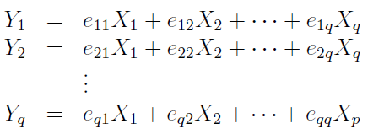
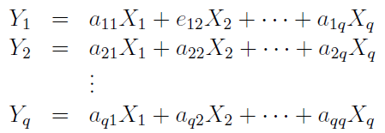
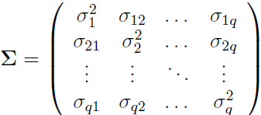
Find the coefficients, $a_{i1}, a_{i2},…a_{iq}$, for a principal component
Eigenvalues & corresponding eigenvectors of Σ
$Σ$ be the covariance matrix associated with $x^{T}=[x_{1}, x_{2},…, x_{q}]$

Slide 4

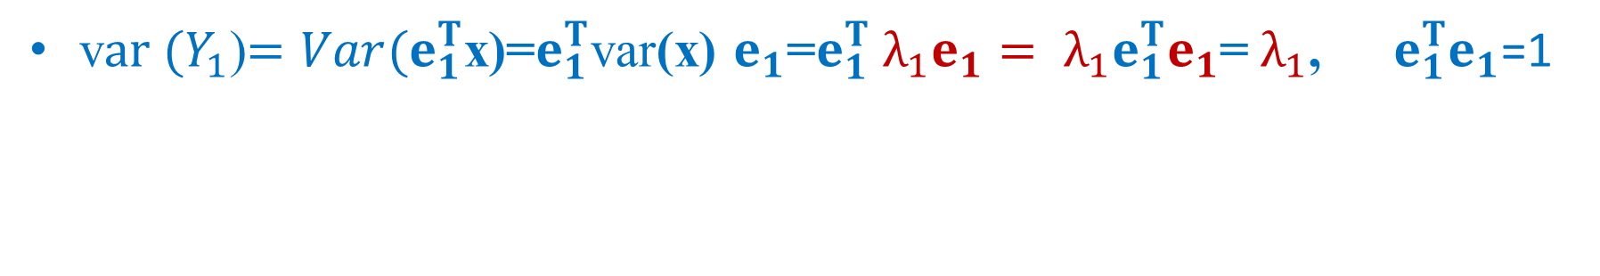
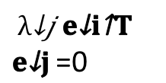
Interpretation of eigenvalues${ λ}_{i}, i=1, 2, …, q$
Let the eigenvalue-eigenvector pairs ($λ_{1}, e_{1}),\left(λ_{2}, e_{2}\right), … (λ_{q}, e_{q}$).
v$ar (Y_{1}$)$=Var(e_{1}^{T}$x)=$e_{1}^{T}$var(x) $e_{1}$=$e_{1}^{T}{ λ}_{1}e_{1}={{ λ}_{1}e}_{1}^{T}e_{1}$=${ λ}_{1}$, $e_{1}^{T}e_{1}$=1
v$ar (Y_{2}$)$=Var(e_{2}^{T}$x)=$e_{2}^{T}$var(x) $e_{2}$=$e_{2}^{T}{ λ}_{2}e_{2}={{ λ}_{2}e}_{2}^{T}e_{2}$=${ λ}_{2}, e_{2}^{T}e_{2}$=1
v$ar (Y_{i}$)$=Var(e_{i}^{T}$x)=$e_{i}^{T}$var(x) $e_{i}$=$e_{i}^{T}{ λ}_{i}e_{i}{{=λ}_{i}e}_{i}^{T}e_{i}$=${ λ}_{i}, e_{i}^{T}e_{i}$=1
c$ov (Y_{i}{, Y}_{j}$)$=e_{i}^{T}cov \left(x_{1},x_{2},…, x_{q}\right)e_{j}=e_{i}^{T}Σe_{j}=e_{i}^{T}{ λ}_{j}e_{j}=$
${ λ}_{j}{e_{i}^{T}e}_{j}$=0

Slide 5



The total variation of PCs
$$Var\left( y_{1}+y_{2}+…+y_{q}\right)=λ_{1}+…+λ_{q}=σ_{1}^{2}+…+σ_{q}^{2}=Trace (Σ)$$
The variation of ith PC
The ith principal component explains the following proportion of the total variation:
The sum of variation for the first $k$ ith PCs
The sum of the first k eigenvalues divided by its total variation:

Slide 6
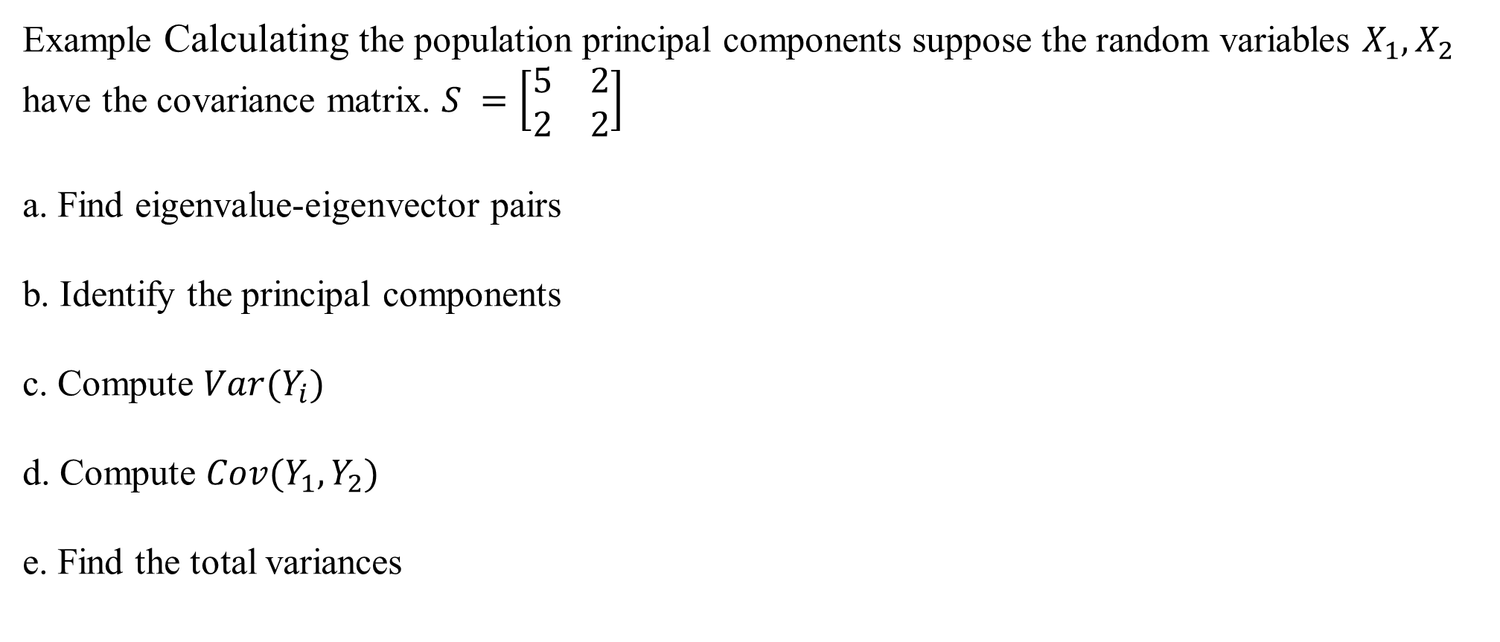

Example Calculating the population principal components suppose the random variables $X_{1}, X_{2}$ have the covariance matrix. $S =\left[\begin{matrix}5 & 2 \\ 2 & 2\end{matrix}\right]$
a. Find eigenvalue-eigenvector pairs
b. Identify the principal components
c. Compute $Var(Y_{i})$
d. Compute $Cov(Y_{1},Y_{2})$
e. Find the total variances
$$−$$

Slide 7
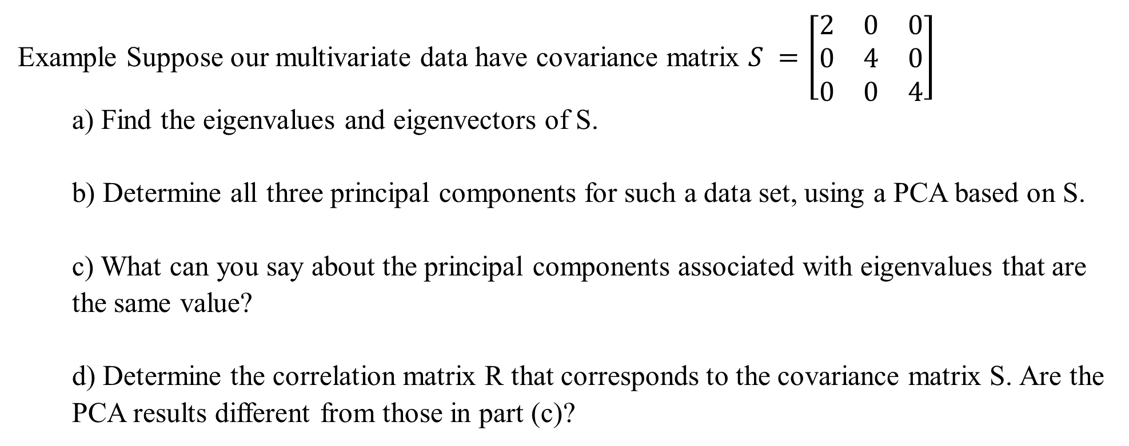
Example Suppose our multivariate data have covariance matrix $S =\left[\begin{matrix}2 & 0 & 0 \\ 0 & 4 & 0 \\ 0 & 0 & 4\end{matrix}\right]$
a) Find the eigenvalues and eigenvectors of S.
b) Determine all three principal components for such a data set, using a PCA based on S.
c) What can you say about the principal components associated with eigenvalues that are the same value?
d) Determine the correlation matrix R that corresponds to the covariance matrix S. Are the PCA results different from those in part (c)?

Slide 8
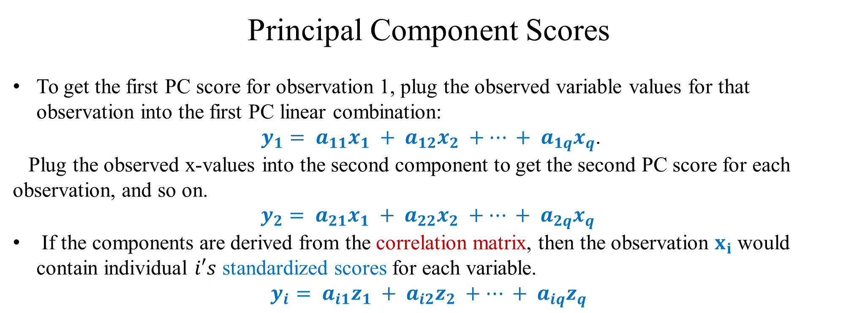
Principal Component Scores
To get the first PC score for observation 1, plug the observed variable values for that observation into the first PC linear combination:
$y_{1}= a_{11}x_{1} + a_{12}x_{2} +⋯ + a_{1q}x_{q}$.
Plug the observed x-values into the second component to get the second PC score for each observation, and so on.
$y_{2}= a_{21}x_{1} + a_{22}x_{2} +⋯ + a_{2q}x_{q}$
If the components are derived from the correlation matrix, then the observation $x_{i}$ would contain individual $i′s$ standardized scores for each variable.
$$y_{i}= a_{i1}z_{1} + a_{i2}z_{2} +⋯ + a_{iq}z_{q}$$

Slide 9
Canonical Correlation Analysis
Principal components analysis considers interrelationships within a set of variables.
Canonical correlation analysis is a method for exploring the relationships between two multivariate sets of variables.
A variable sets
Exactly one variable
2) One response (or dependent) variable
Another variable sets
Exactly one variable
2) Several explanatory variables
Correlation analysis, Simple linear regression analysis
Multiple linear regression analysis

Slide 10
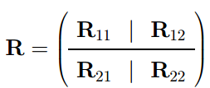

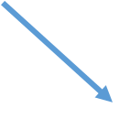


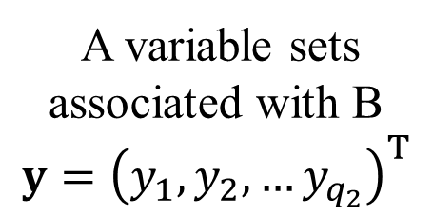
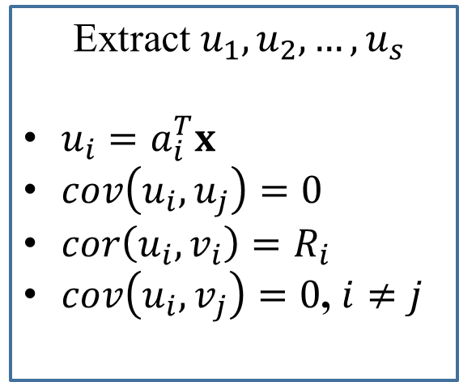
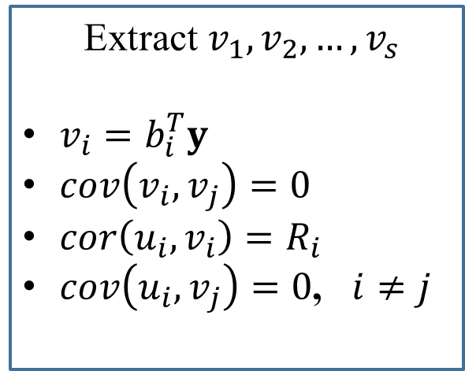
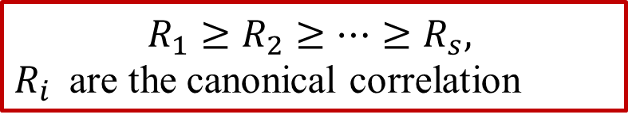



$(q_{1} + q_{2}) × (q_{1} + q_{2})$correlation matrix
$cor(x)=R_{11}$, q1 × q1 sample cor matrix of $x$ $cor\left(x,y\right)=R_{12}=R_{21}=cor(y,x)$, q1 × q2 cor matrix between the x’s and the y’s
$cor(y)=R_{22}$, q2 × q2 sample cor matrix of $y$
A variable sets
associated with A
$$x={\left(x_{1},x_{2},…x_{q_{1}}\right)}^{T}$$
A variable sets
associated with B
$$y={\left(y_{1},y_{2},…y_{q_{2}}\right)}^{T}$$
Extract $u_{1},u_{2},…, u_{s}$
$u_{i}=a_{i}^{T}x$
$cov\left(u_{i}, u_{j}\right)=0$
$cor\left(u_{i}, v_{i}\right)=R_{i}$
$cov\left(u_{i}, v_{j}\right)=0$, $i≠j$
canonical variates
Extract $v_{1},v_{2},…, v_{s}$
$v_{i}=b_{i}^{T}y$
$cov\left(v_{i}, v_{j}\right)=0$
$cor\left(u_{i}, v_{i}\right)=R_{i}$
$cov\left(u_{i}, v_{j}\right)=0$, $i≠j$
$${{ R}_{22}}^{−1}R_{21}{R_{11}}^{−1}R_{12}$$
$${{ R}_{11}}^{−1}R_{12}{R_{22}}^{−1}R_{21}$$
$$\left(u_{i}, v_{i}\right)$$
$$R_{1}≥R_{2}≥…≥R_{s},$$
$R_{i}$ are the canonical correlation

Slide 11

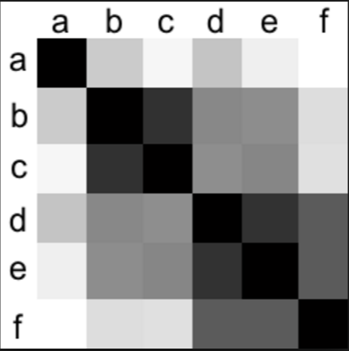


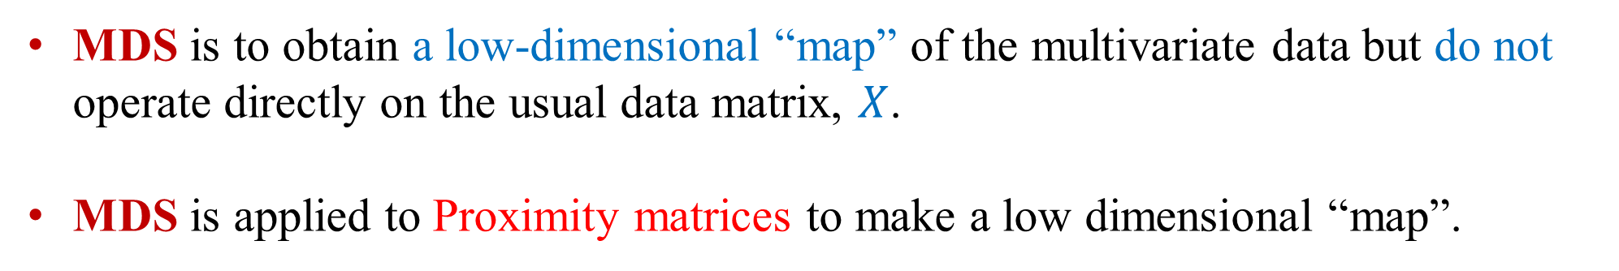
MDS is to obtain a low-dimensional “map” of the multivariate data but do not operate directly on the usual data matrix, $X$.
MDS is applied to Proximity matrices to make a low dimensional “map”.
Distance, Dissimilarity or Similarity
matrices
Without $X$
A low-dimensional “map”
Understand $X$

Slide 12
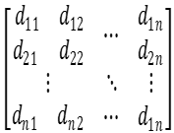


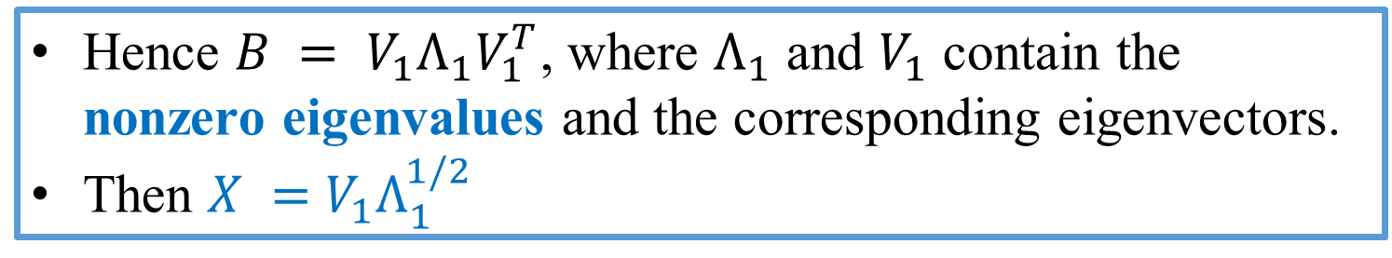

Original $X$
Visualize data
$$Distance Matrix$$
Multidimensional scaling (MDS) essentially reverses that process:
Reconstruct a map as closely as possible representing original data with small # of dimension located
Proximity matrix
Recover $X$
Distance, Dissimilarity or Similarity
matrices
Hence $B = V_{1}Λ_{1}V_{1}^{T}$, where $Λ_{1}$ and $V_{1}$ contain the nonzero eigenvalues and the corresponding eigenvectors.
Then $X =$ $V_{1}Λ_{1}^{1/2}$

Slide 13

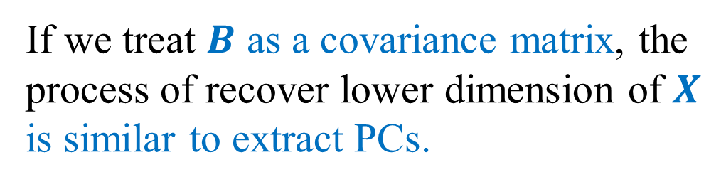

PCA and MDS Solutions
The PCs extracted from covariance matrix S equal the coordinates of the MDS solution if D is Euclidean Distance.
If we treat $B$ as a covariance matrix, the process of recover lower dimension of $X$ is similar to extract PCs.
X
S
D
PCs
$$B$$
PC scores
$$V_{1}Λ_{1}^{1/2}$$

Slide 14
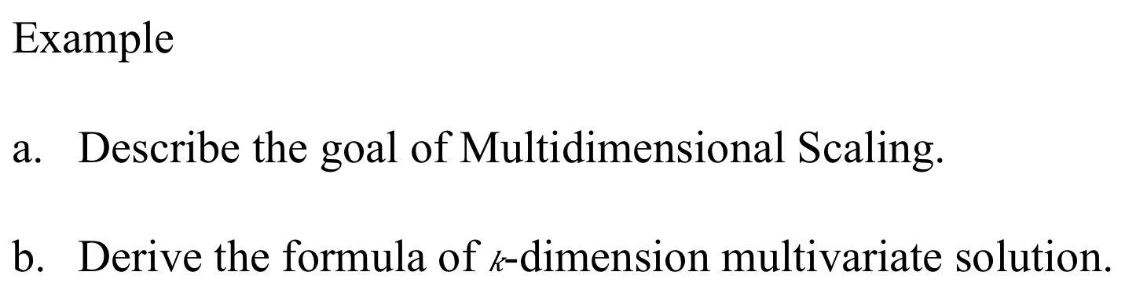
Example
Describe the goal of Multidimensional Scaling.
Derive the formula of $k$-dimension multivariate solution.

Slide 15
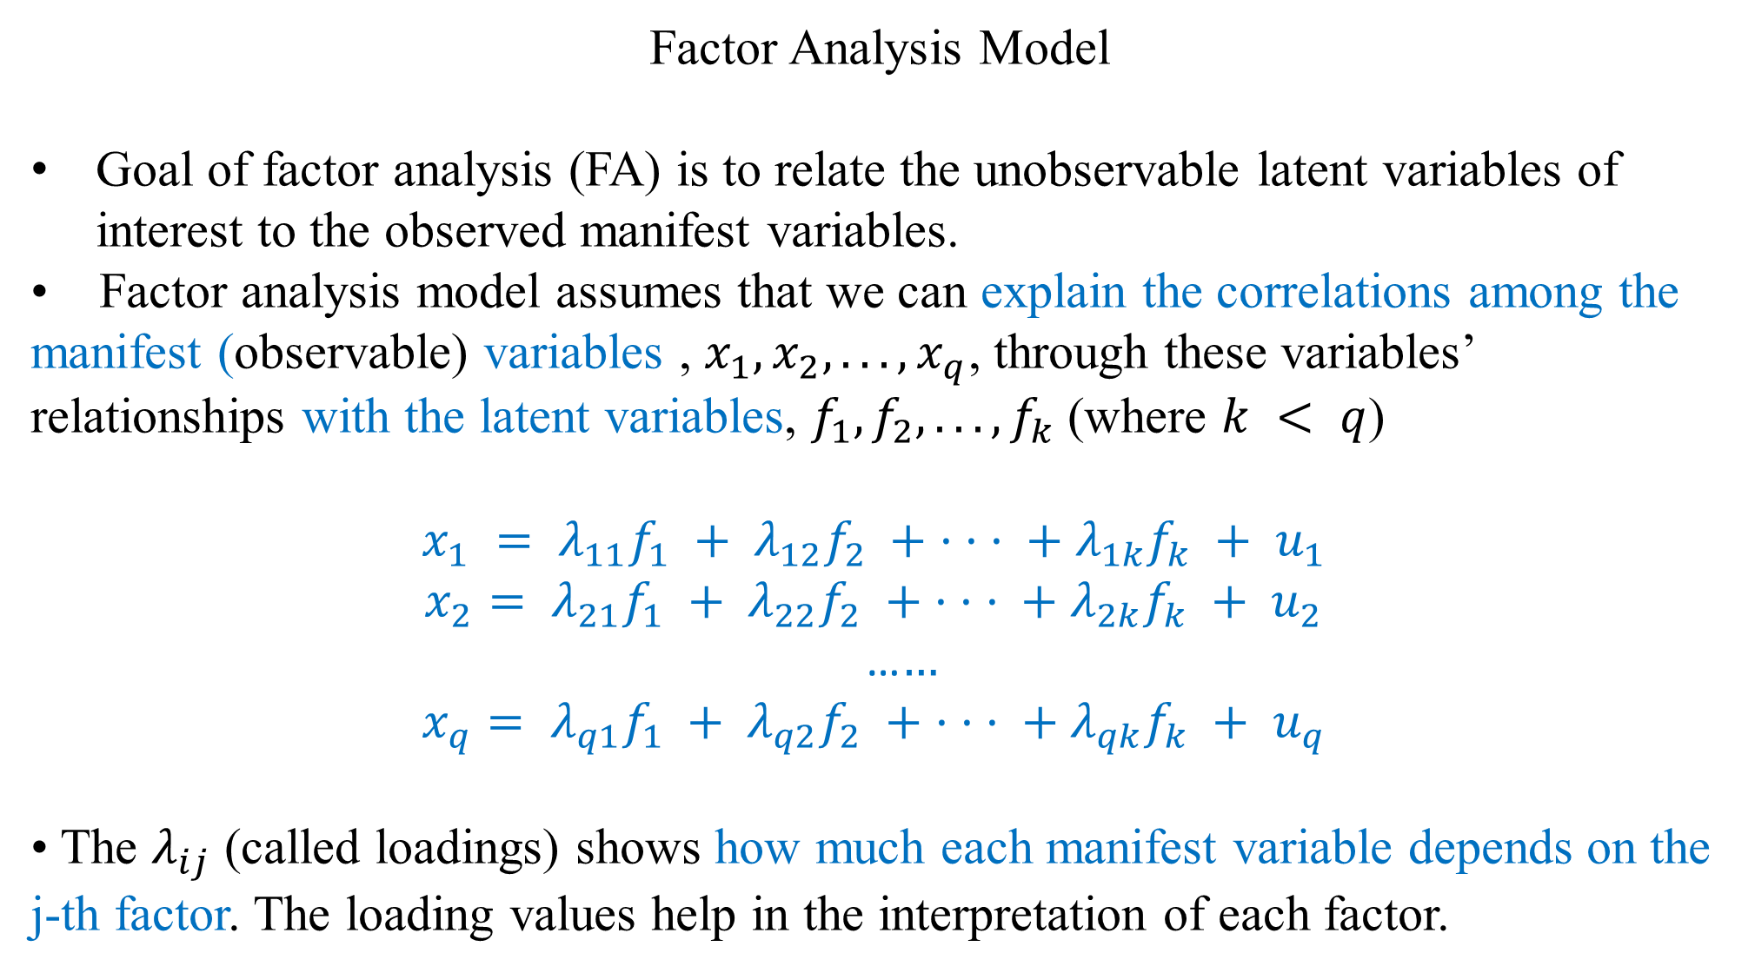
Factor Analysis Model
Goal of factor analysis (FA) is to relate the unobservable latent variables of interest to the observed manifest variables.
• Factor analysis model assumes that we can explain the correlations among the manifest (observable) variables , $x_{1}, x_{2}, . . ., x_{q}$, through these variables’ relationships with the latent variables, $f_{1}, f_{2}, . . ., f_{k}$ (where $k < q$)
$$x_{1} = λ_{11}f_{1} + λ_{12}f_{2} + · · · + λ_{1k}f_{k} + u_{1}$$
$$x_{2}= λ_{21}f_{1} + λ_{22}f_{2} + · · · + λ_{2k}f_{k} + u_{2}$$
…$…$
$$x_{q}= λ_{q1}f_{1} + λ_{q2}f_{2} + · · · + λ_{qk}f_{k} + u_{q}$$
• The $λ_{ij}$ (called loadings) shows how much each manifest variable depends on the j-th factor. The loading values help in the interpretation of each factor.

Slide 16
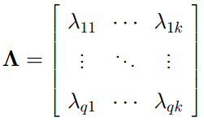
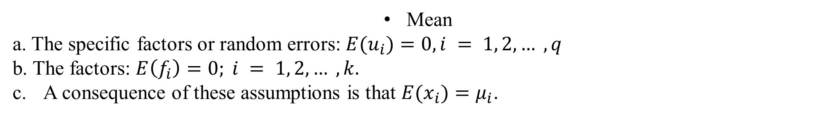
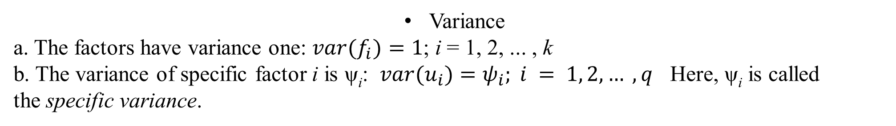
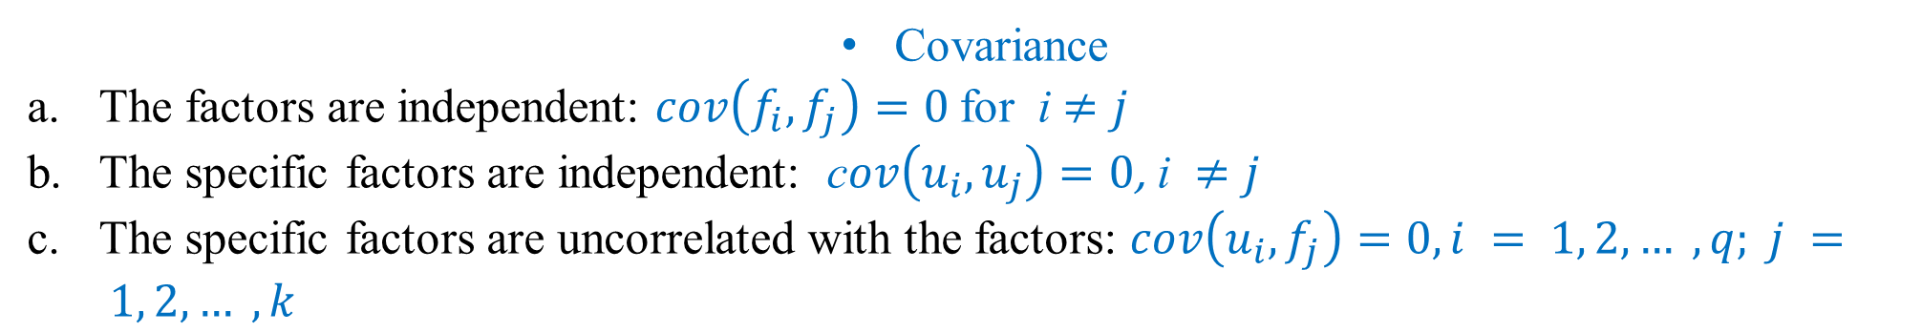
$x = Λf + u$, , $f= {\left(f_{1}, . . ., f_{k}\right)}^{T}, u = {\left(u_{1}, . . ., u_{q}\right)}^{T}$.
Mean
a. The specific factors or random errors: $E(u_{i})=0, i = 1, 2, … , q$
b. The factors: $E\left(f_{i}\right)=0; i = 1, 2, … , k.$
A consequence of these assumptions is that $E(x_{i})=μ_{i}$.
Variance
a. The factors have variance one: $var(f_{i})=1$; i = 1, 2, ... , k
b. The variance of specific factor i is ψ_{i}: $var(u_{i})=ψ_{i}; i = 1, 2, … , q$ Here, ψ_{i} is called the specific variance.
Covariance
The factors are independent: $cov\left(f_{i}, f_{j}\right)=0$for i $≠j$
The specific factors are independent: c$ov\left(u_{i}, u_{j}\right)=0\text{,} \text{i} ≠j$
The specific factors are uncorrelated with the factors: $cov\left(u_{i},f_{j}\right)=0,i = 1, 2, … , q; j = 1, 2, … , k$

Slide 17
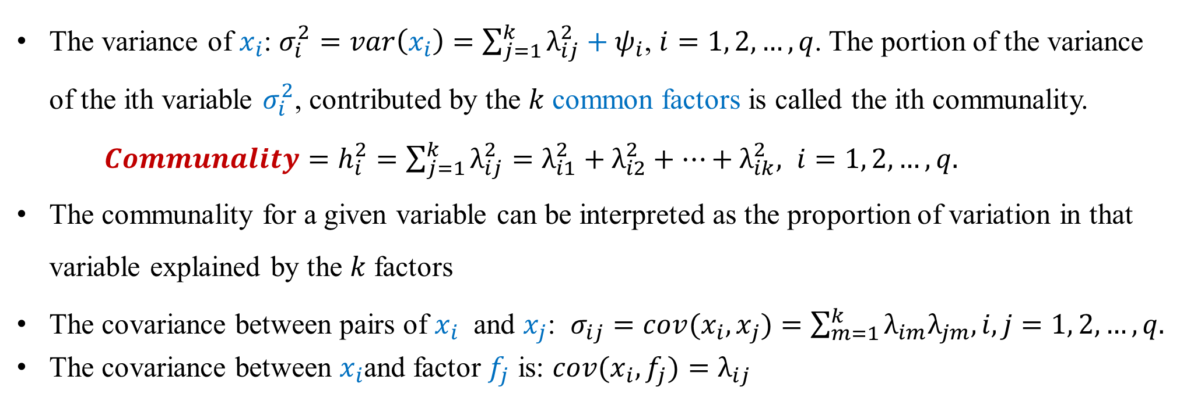

Factor Analysis Model
• manifest variables: $x_{1}, x_{2}, . . ., x_{q}$. latent variables or factors: $f_{1}, f_{2}, . . ., f_{k}$.
$x = Λf + u$, , $f= {\left(f_{1}, . . ., f_{k}\right)}^{T}, u = {\left(u_{1}, . . ., u_{q}\right)}^{T}$.
The variance of $x_{i}$: $σ_{i}^{2}=var\left(x_{i}\right)=\sum_{j=1}^{k}{λ_{ij}^{2}}+ψ_{i}$, $i=1, 2, …, q$. The portion of the variance of the ith variable $σ_{i}^{2}$, contributed by the $k$ common factors is called the ith communality. $Communality=h_{i}^{2}=\sum_{j=1}^{k}{λ_{ij}^{2}=λ_{i1}^{2}+λ_{i2}^{2}+…+λ_{ik}^{2}, i=1, 2, …, q.}$
The communality for a given variable can be interpreted as the proportion of variation in that variable explained by the $k$ factors
The covariance between pairs of $x_{i}$ and $x_{j}$: $σ_{ij}=cov(x_{i},x_{j})=\sum_{m=1}^{k}{λ_{im}λ_{jm}, i,j=1, 2, …,q.}$
The covariance between $x_{i}$and factor $f_{j}$ is: $cov(x_{i},f_{j})=λ_{ij}$

Slide 18
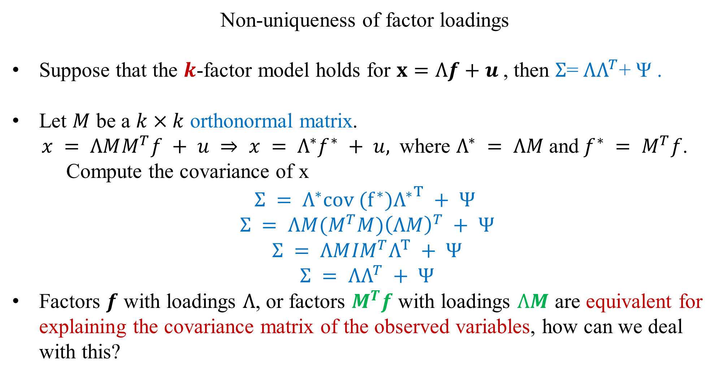
Non-uniqueness of factor loadings
Suppose that the $k$-factor model holds for $x=Λf+u$, then $Σ$= $ΛΛ^{T}$+ Ψ .
Let $M$ be a $k×k$ orthonormal matrix.
$x = ΛMM^{T}f + u ⇒ x = Λ^{∗}f^{∗} + u,$where $Λ^{∗} = ΛM$and$f^{∗} = M^{T}f$.
Compute the covariance of x
$$Σ = Λ^{∗}{{cov (f^{∗})Λ}^{∗}}^{T} + Ψ$$
$$Σ = ΛM{{(M}^{T}M)\left(ΛM\right)}^{T} + Ψ$$
$$Σ = ΛM{IM}^{T}Λ^{T} + Ψ$$
$$Σ = ΛΛ^{T} + Ψ$$
Factors $f$ with loadings $Λ$, or factors $M^{T}f$ with loadings $ΛM$ are equivalent for explaining the covariance matrix of the observed variables, how can we deal with this?

Slide 19
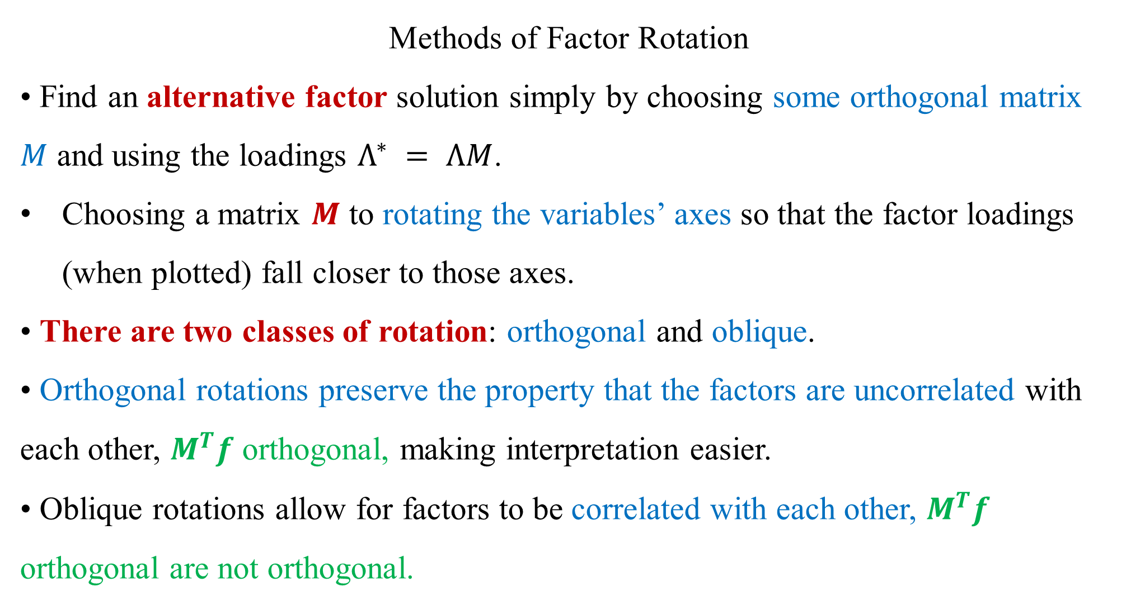
Methods of Factor Rotation
• Find an alternative factor solution simply by choosing some orthogonal matrix $M$ and using the loadings $Λ^{∗} = ΛM$.
Choosing a matrix $M$ to rotating the variables’ axes so that the factor loadings (when plotted) fall closer to those axes.
• There are two classes of rotation: orthogonal and oblique.
• Orthogonal rotations preserve the property that the factors are uncorrelated with each other, $M^{T}f$ orthogonal, making interpretation easier.
• Oblique rotations allow for factors to be correlated with each other, $M^{T}f$ orthogonal are not orthogonal.

Slide 20
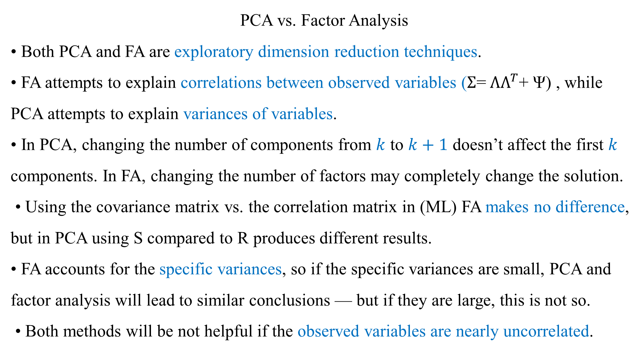
PCA vs. Factor Analysis
• Both PCA and FA are exploratory dimension reduction techniques.
• FA attempts to explain correlations between observed variables ($Σ$= $ΛΛ^{T}$+ Ψ) , while PCA attempts to explain variances of variables.
• In PCA, changing the number of components from $k$ to $k+1$ doesn’t affect the first $k$ components. In FA, changing the number of factors may completely change the solution.
• Using the covariance matrix vs. the correlation matrix in (ML) FA makes no difference, but in PCA using S compared to R produces different results.
• FA accounts for the specific variances, so if the specific variances are small, PCA and factor analysis will lead to similar conclusions — but if they are large, this is not so.
• Both methods will be not helpful if the observed variables are nearly uncorrelated.

Slide 21
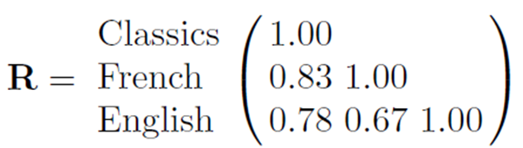
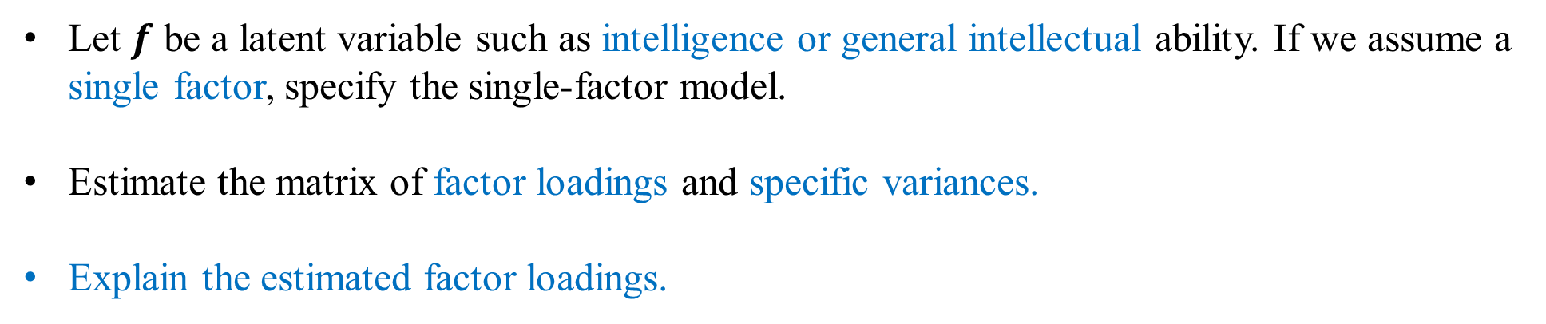
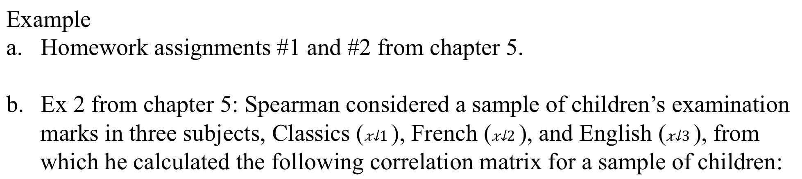
Example
Homework assignments #1 and #2 from chapter 5.
Ex 2 from chapter 5: Spearman considered a sample of children’s examination marks in three subjects, Classics ($x_{1}$), French ($x_{2}$), and English ($x_{3}$), from which he calculated the following correlation matrix for a sample of children:
Let $f$ be a latent variable such as intelligence or general intellectual ability. If we assume a single factor, specify the single-factor model.
Estimate the matrix of factor loadings and specific variances.
Explain the estimated factor loadings.

Slide 22
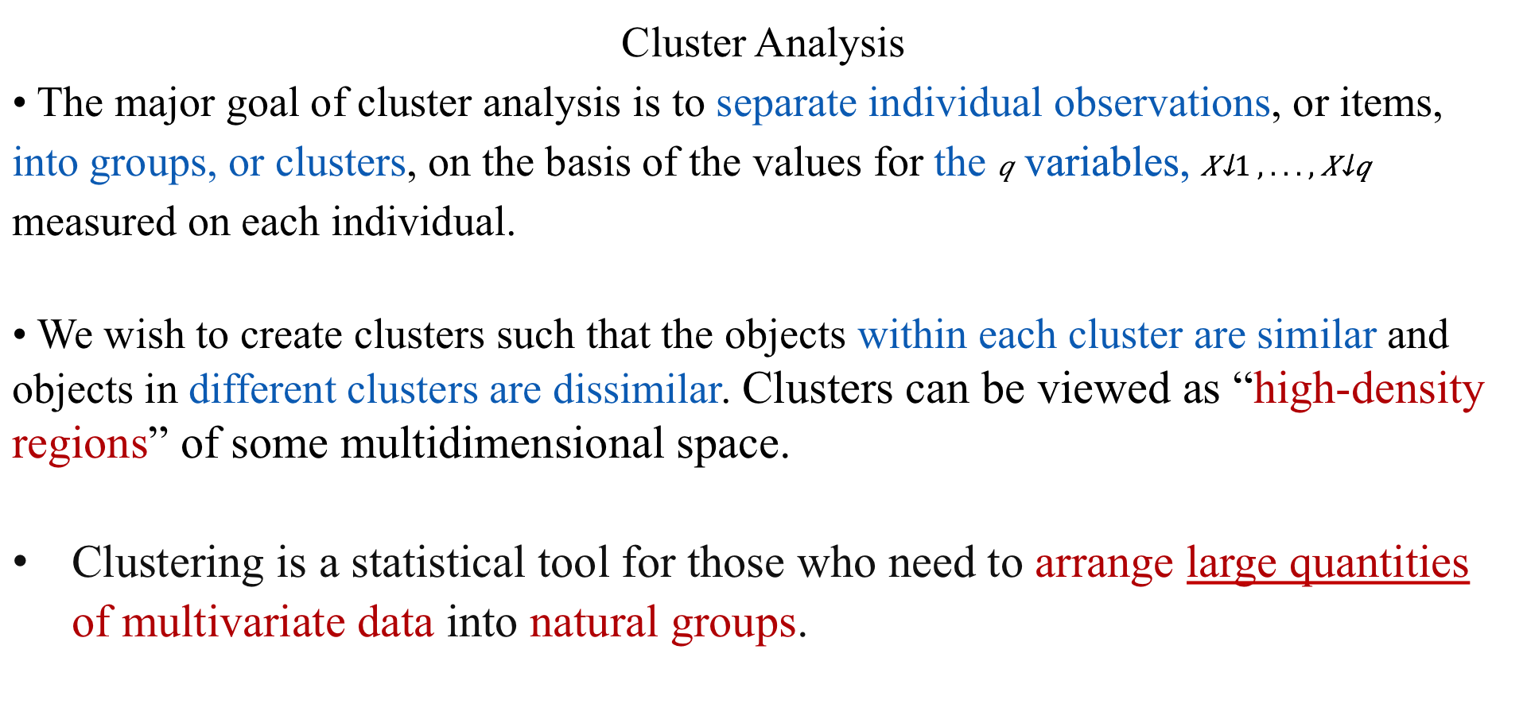
Cluster Analysis
• The major goal of cluster analysis is to separate individual observations, or items, into groups, or clusters, on the basis of the values for the $q$ variables, $X_{1}, . . . , X_{q}$ measured on each individual.
• We wish to create clusters such that the objects within each cluster are similar and objects in different clusters are dissimilar. Clusters can be viewed as “high-density regions” of some multidimensional space.
Clustering is a statistical tool for those who need to arrange large quantities of multivariate data into natural groups.

Slide 23
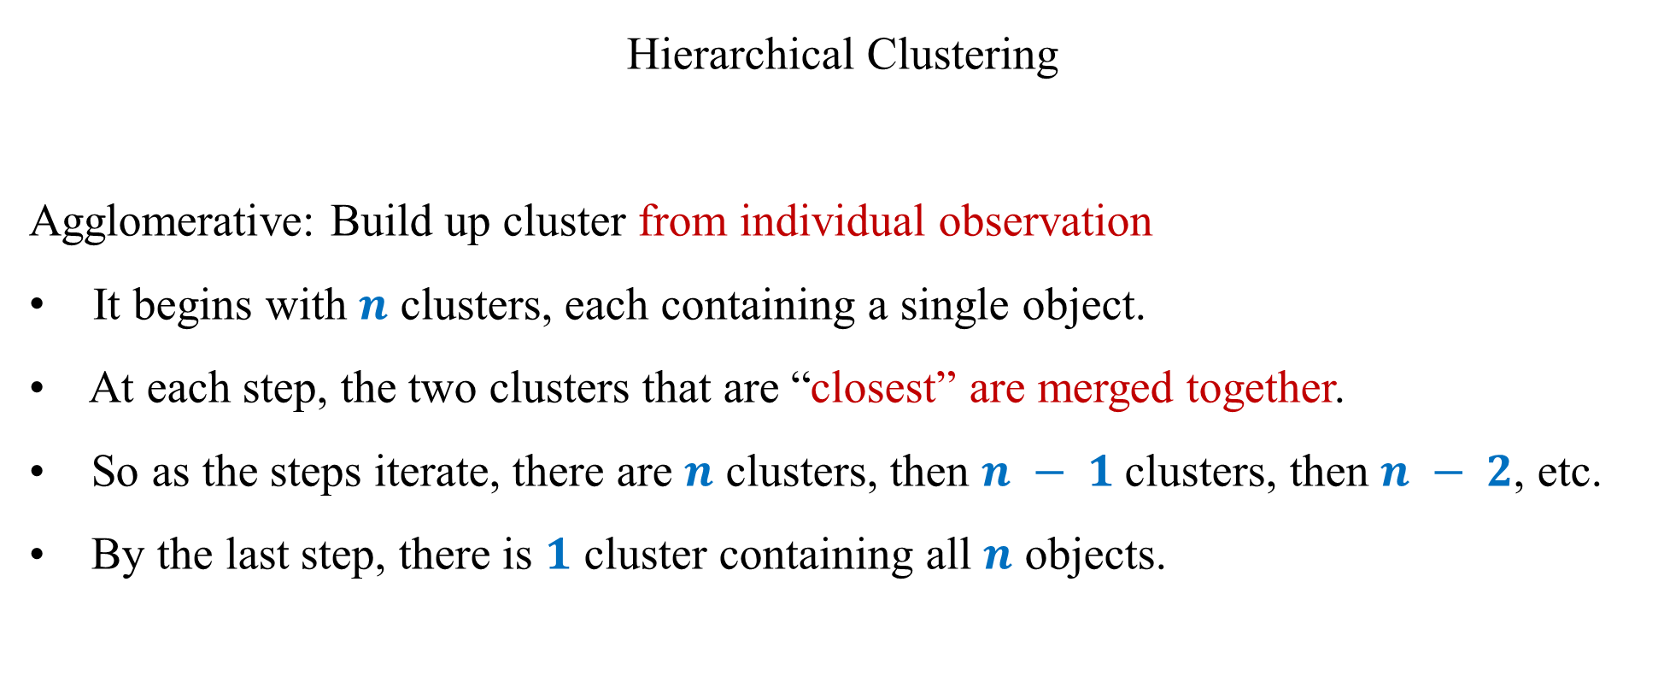
Hierarchical Clustering
Agglomerative: Build up cluster from individual observation
It begins with $n$ clusters, each containing a single object.
• At each step, the two clusters that are “closest” are merged together.
• So as the steps iterate, there are $n$ clusters, then $n − 1$clusters, then $n − 2$, etc.
• By the last step, there is $1$ cluster containing all $n$ objects.

Slide 24


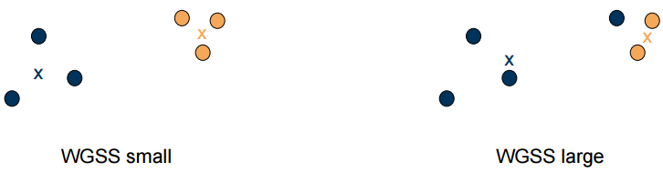
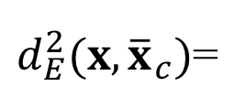
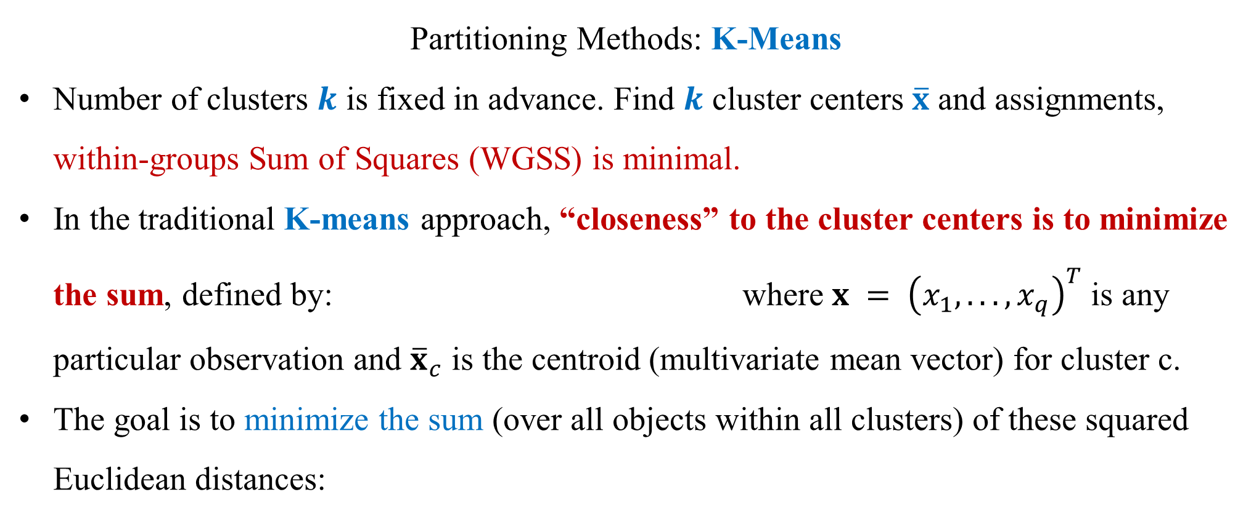
Partitioning Methods: K-Means
Number of clusters $k$ is fixed in advance. Find $k$ cluster centers $\overline{x}$ and assignments, within-groups Sum of Squares (WGSS) is minimal.
In the traditional K-means approach, “closeness” to the cluster centers is to minimize the sum, defined by: where $x = {\left(x_{1}, . . . , x_{q}\right)}^{T}$is any particular observation and ${\overline{x}}_{c}$ is the centroid (multivariate mean vector) for cluster c.
The goal is to minimize the sum (over all objects within all clusters) of these squared Euclidean distances:
$d_{E}^{2}(x, {\overline{x}}_{c})$=

Slide 25
Example Homework assignments #1 and #3
Example All the questions from in class exam I

Slide 26
Structure of in class final exam (in class portion, 20% of the final exam)
Chapter 2 (10 pts)
Chapter 3 (25 pts)
Chapter 4 (10 pts)
Chapter 5 (40 pts)
Chapter 6 (15 pts)

